Slide 1

Spatial News
Data and Methodology
Localization of
incidents within a community
Callie Wentling
Professor Marco Painho

Slide 2
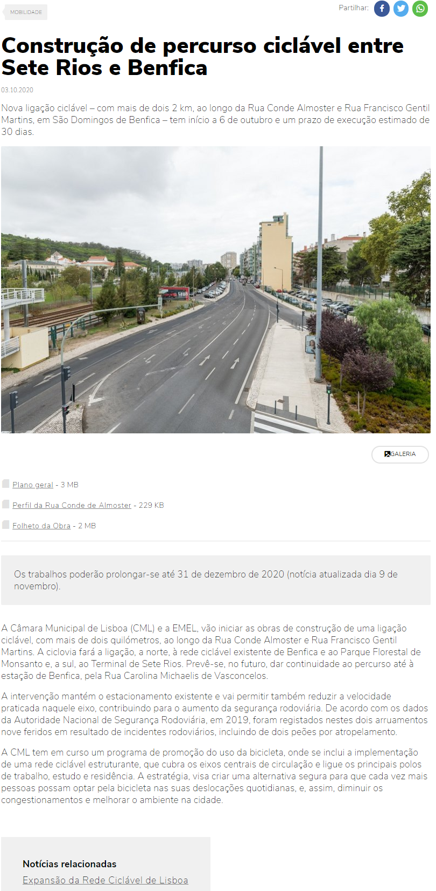
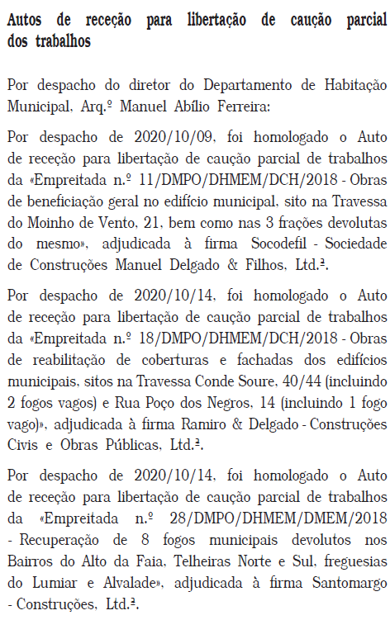
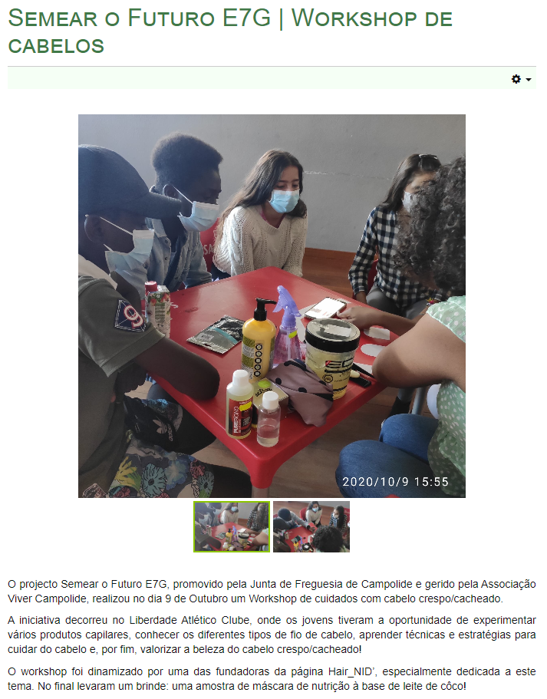
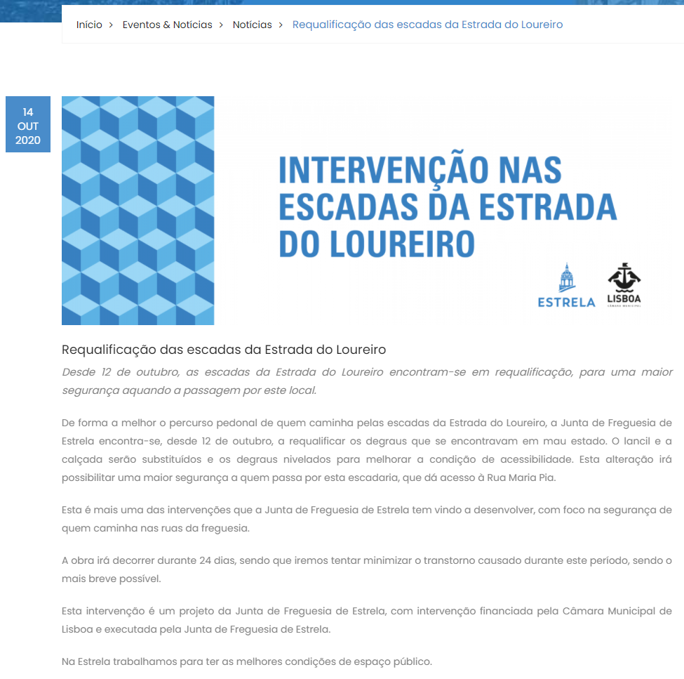
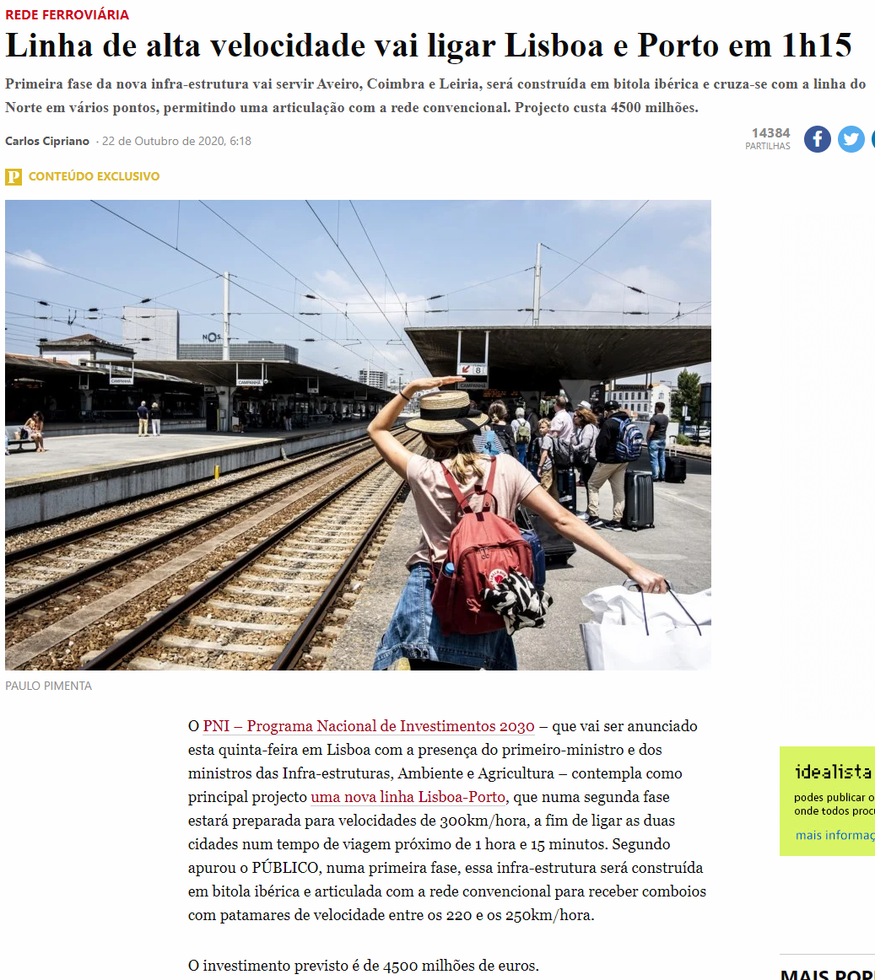






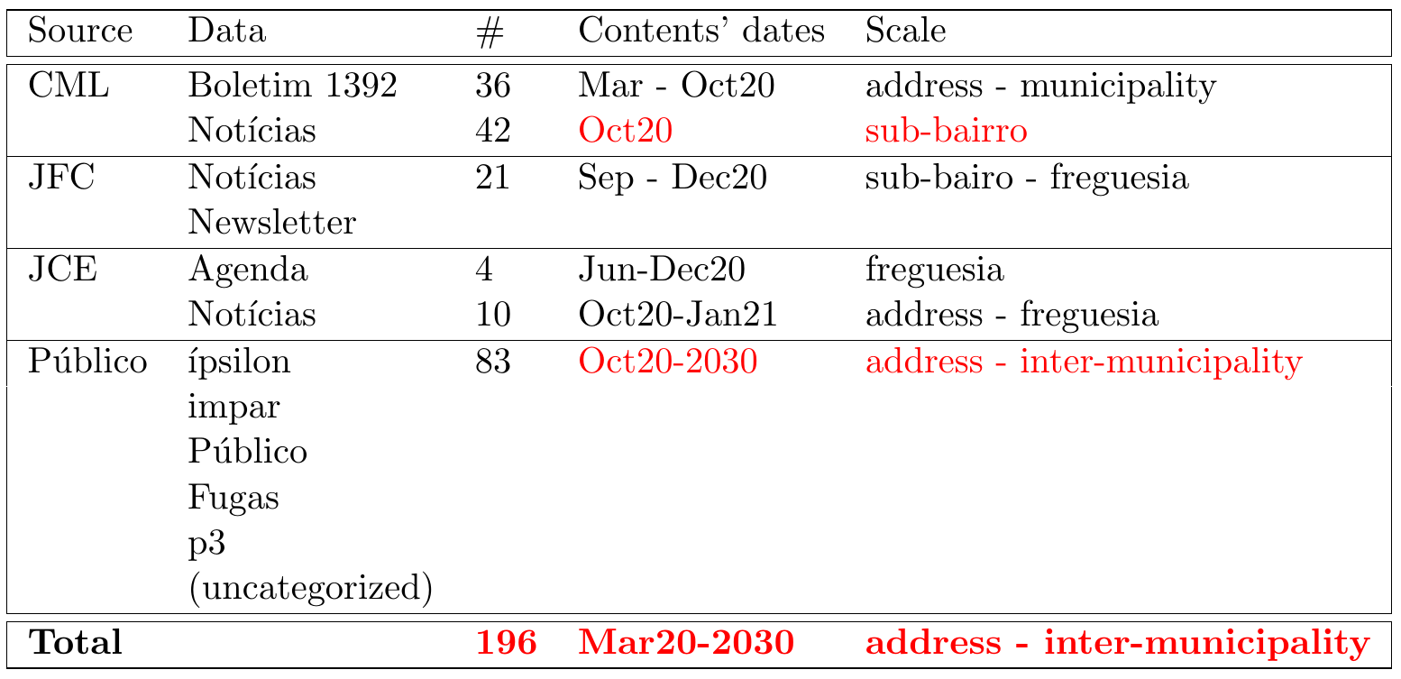
Data: Corpora
October 2020
Title / Contents / Publication Date/ Source / Link
Times / Places / Author / Themes
Summary / Photo / Section / Referenced articles / Related articles

Slide 3
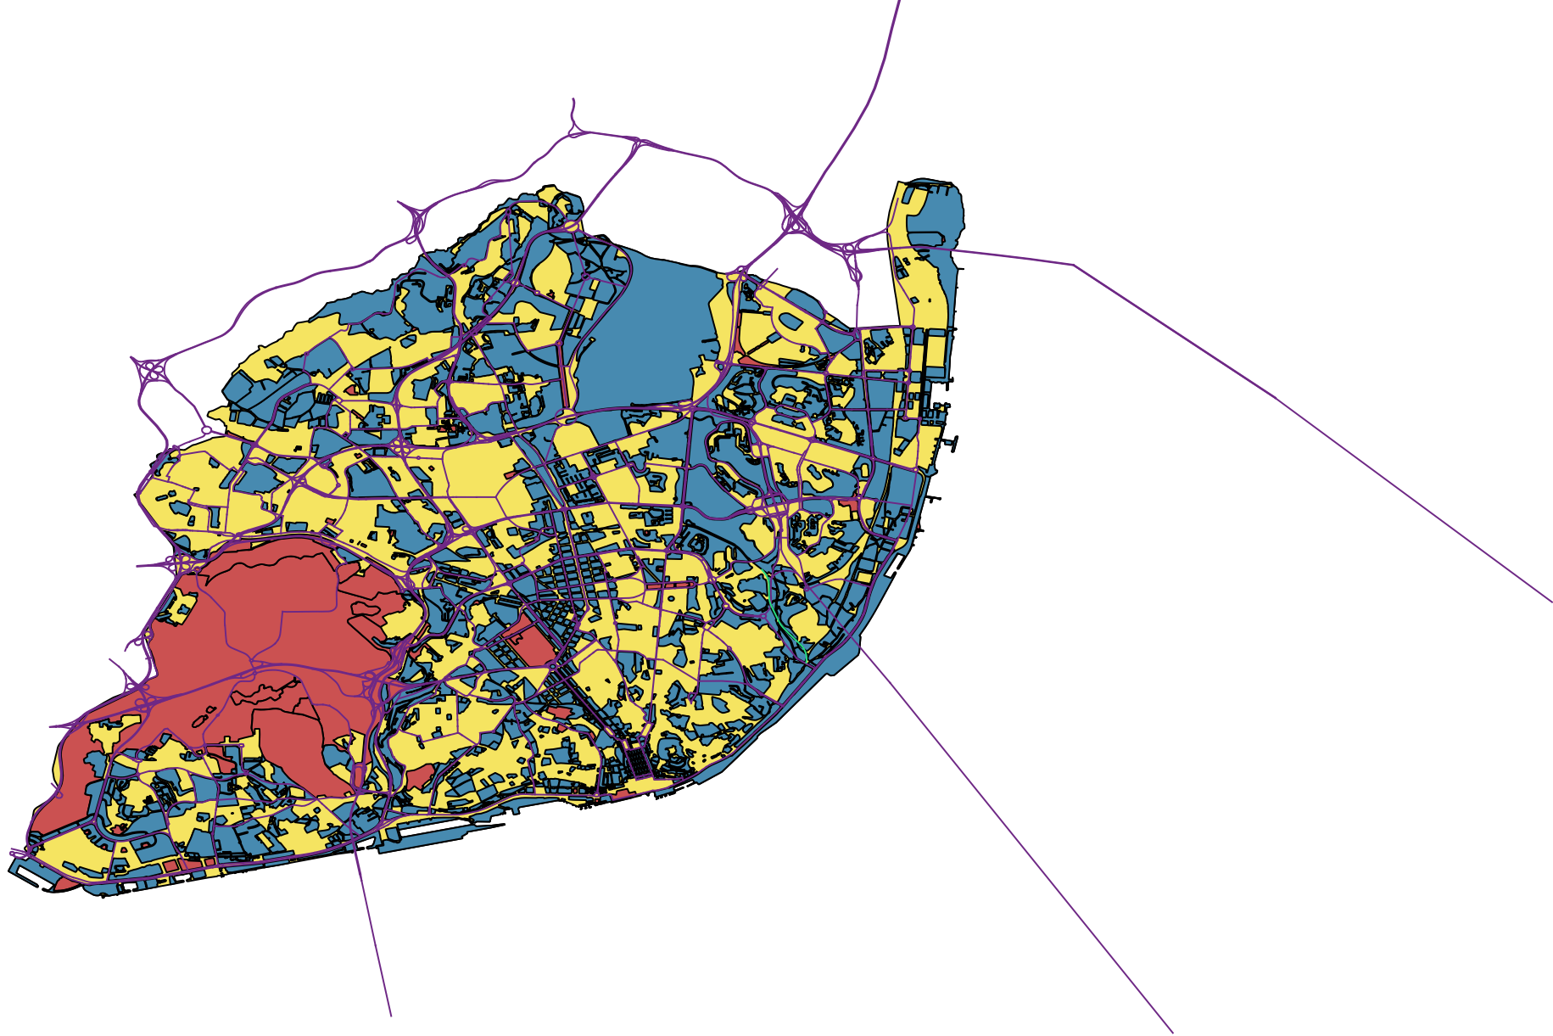
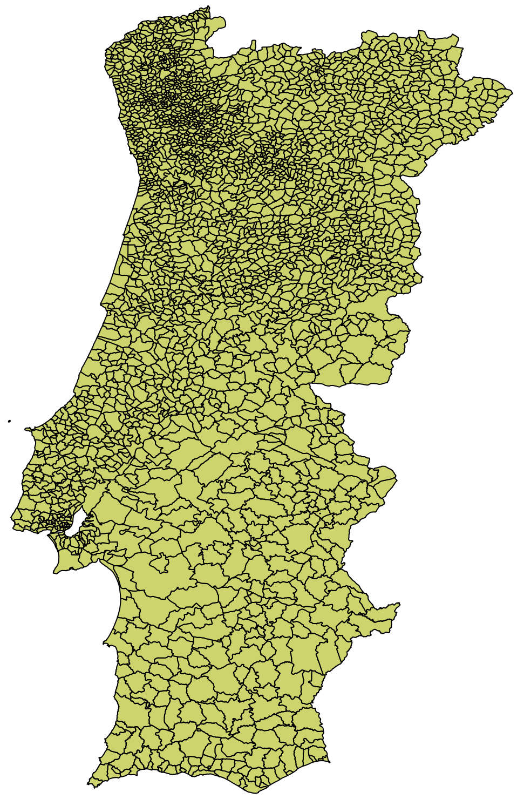

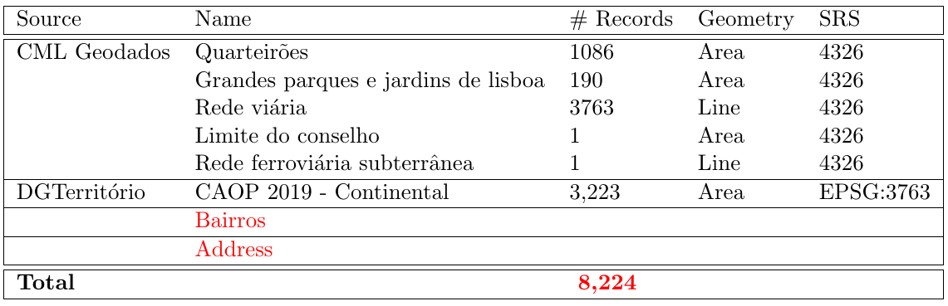

Data: Base maps

Slide 4
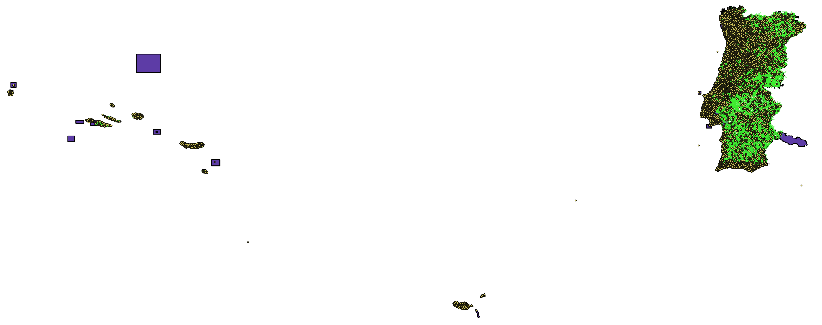



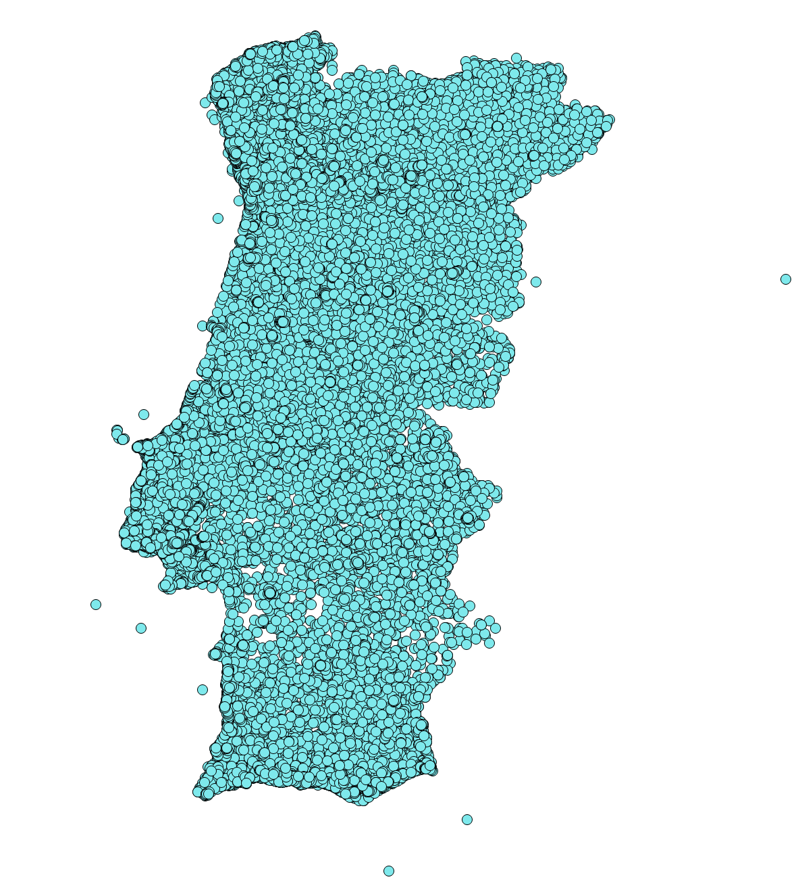
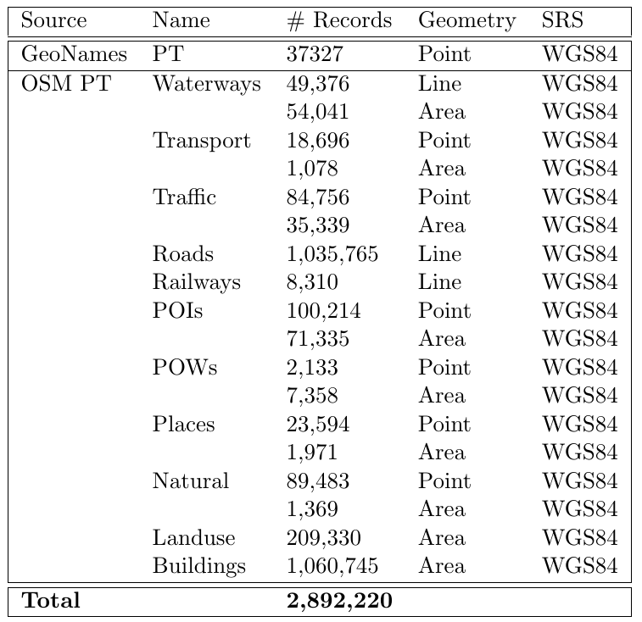

Data: Gazetteers

Slide 5
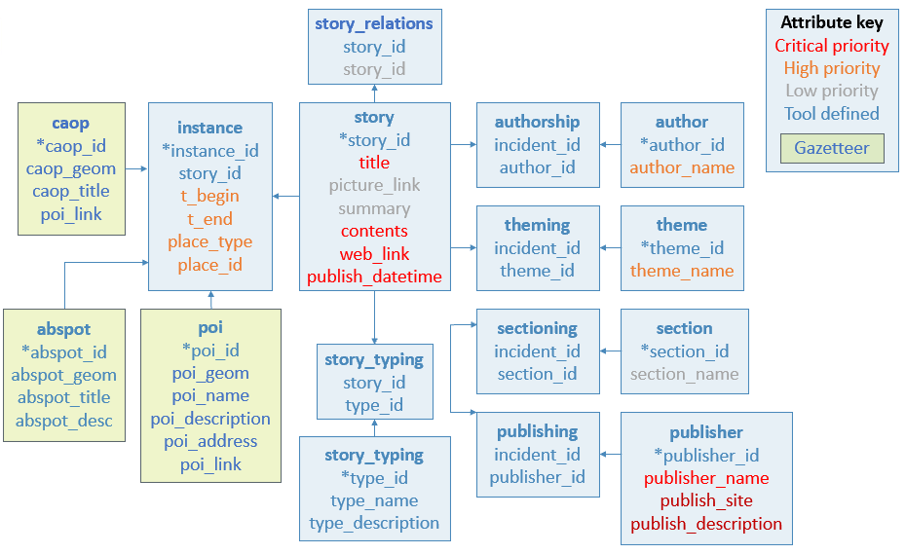
Methodology: Data model
Notes:
This is the current working data model. The items in red are expected to be provided by the news data sources.

Slide 6
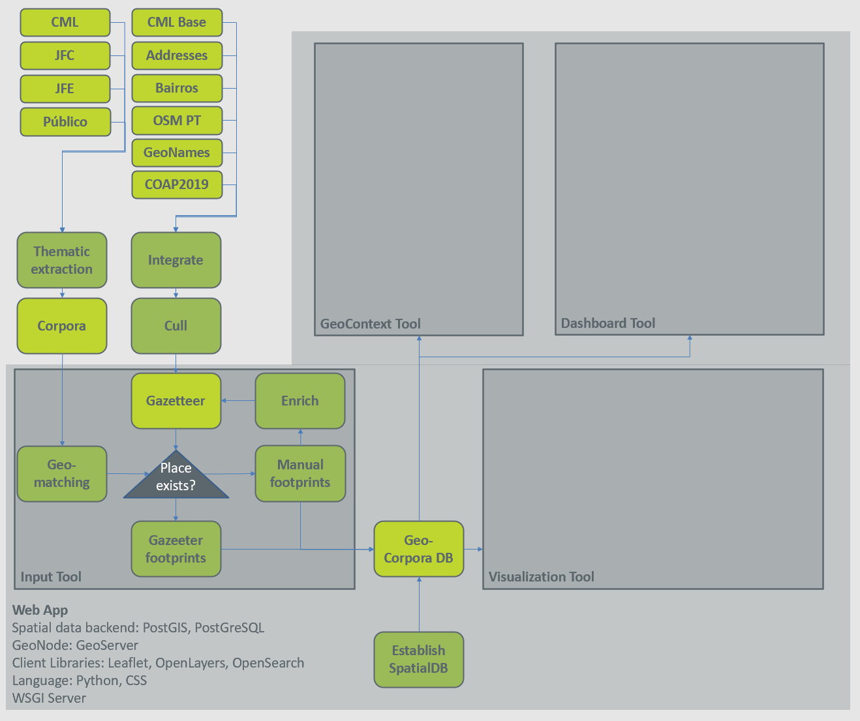
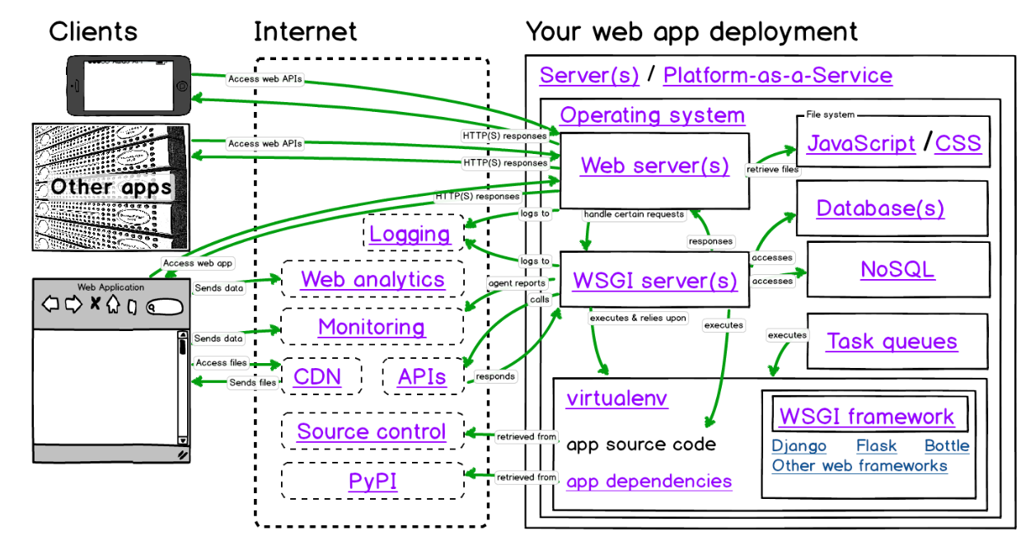
Methodology: ?
GeoNode
GeoServer
Spatial Data Backend: PostGIS PostGreSQL
CML
CML Base
JFC
Addresses
GeoContext Tool
Dashboard Tool
JFE
Bairros
Público
OSM PT
GeoNames
COAP2019
Thematic extraction
Integrate
Corpora
Cull
Web App
Spatial data backend: PostGIS, PostGreSQL
GeoNode: GeoServer
Client Libraries: Leaflet, OpenLayers, OpenSearch
Language: Python, CSS
WSGI Server
Input Tool
Visualization Tool
Gazetteer
Enrich
Geo-matching
Place exists?
Manual footprints
Gazeeter footprints
Geo-Corpora DB
Establish SpatialDB

Slide 7
Status: Momentum
Literature resources accumulated and reviewed. Finalize draft. Engage programming advisor.
Corpora sample data collection complete with coherence to a single data model style. Establish GeoCorpora DB.
Basemaps (COAP, CML) included. Address and Bairro gazetteer.
Gazetteer data (GeoNames, OSM PT) loaded. Integrate and cull full gazetteer.
Updated data model. Validate.
Collaboration with a hyperlocal news project in Lisbon. Build plugin.

Slide 8

Thank you!
Discussion
Address: Campus de Campolide, 1070-312 Lisboa, Portugal
Tel: +351 213 828 610 | Fax: +351 213 828 611

Slide 9
Status: Questions
What to present during ANALYSIS AND RESULTS meeting?

Slide 10
References
[1] Greg G. Brown and David V. Pullar. An evaluation of the use of points versus polygons in pub-
lic participation geographic information systems using quasi-experimental design and Monte Carlo
simulation. International Journal of Geographical Information Science, 26(2):231–246, 2012.
[2] OpenStreetMap.
[3] Jennifer Evans-Cowley and Justin Hollander. The new generation of public participation: Internet-based participation tools. Planning Practice and Research, 25(3):397–408, 2010.
[4] Eric Fisher. Making the most detailed tweet map ever, dec 2014.
[5] Fabio Parasecoli and Mateusz Halawa. Rethinking the global table. In May Rosenthal and Catherine Flood, editors, Food: Bigger than the plate, pages 80–89. Victoria and Albert Museum, London, 2019.
[6] Devanjan Bhattacharya and Marco Painho. Location intelligence for augmented smart cities integrating sensor web and spatial data infrastructure (SmaCiSENS). GISTAM 2018 - Proceedings of the 4th International Conference on Geographical Information Systems Theory, Applications and Management, 2018-March(Gistam):282–289, 2018.
[7] Tiago H Moreira De Oliveira and Marco Painho. Open Geospatial Data Contribution Towards Sentiment Analysis Within the Human Dimension of Smart Cities. In A Mobasheri, editor, Open Source Geospatial Science for Urban Sudies., pages 75–95. Springer International Publishing, 2021.
[8] Alexandria Digital Library Gazetteer — UCSB Library, 2019.
[9] The Denver Post, 2020.
10] Ben Shneiderman. The Eyes Have It: A Task by Data Type Taxonomy for Information Visualizations. Technical report, University of Maryland, College Park, jul 1996.
11] Jayna McQueen Baker, Gabriel Huddleston, and Erin Atwood. The Map as Object: Working Beyond Bounded Realities and Mapping for Social Change. Educational Research for Social Change, 8(1):13–152, 2019.
[12] ESRI. What is LocateXT.
[13] Michelle Rial. Am I overthinking this? Over-answers life’s questions in 101 charts. Chronicle Books, San Francisco, United Sates, aug 2019.
[14] Massey D. A Global Sense Of Place. Marxism Today, June(June):24–29, 1991.
[15] Sabine Witschas. Cross-border mapping-Geodata and Geonames. Technical report, 2004.
[16] Jerry Low. How to Host Your Own Website: Step-by-step Tutorial, sep 2020.
[17] Nader Afzalan, Thomas W. Sanchez, and Jennifer Evans-Cowley. Creating smarter cities: Considerations for selecting online participatory tools. Cities, 67(April):21–30, 2017.
[18] Greg G. Brown and David V. Pullar. An evaluation of the use of points versus polygons in pub-
lic participation geographic information systems using quasi-experimental design and Monte Carlo
simulation. International Journal of Geographical Information Science, 26(2):231–246, 2012.
[19] Ramiz Sami. Tools I recommend for building Geospatial Web Applications — by Ramiz Sami — The Startup — Medium, oct 2019.
[20] Reinout Kleinhans, Maarten Van Ham, and Jennifer Evans-Cowley. Using Social Media and Mo-
bile Technologies to Foster Engagement and Self-Organization in Participatory Urban Planning and
Neighbourhood Governance. Planning Practice and Research, 30(3):237–247, 2015.
[21] Karina Popova. Politicization of non-political events: A Geospatial Analysis of Twitter Content
During The 2014 FIFA World Cup. 2015.
[22] Cláudia Henriques, Pedro Marques Gomes, and Sı́lvia Marques Torres. OS MÉDIA NO PORTUGAL
CONTEMPORÂNEO: da ditadura à democ. Imprensa da Universidade de Coimbra, 35:19(2), 2019.
[23] Stig Hjarvard. The mediatization of culture and society. 2013.
[24] Ulrich Drepper, Jim Meyering, François Pinard, and Bruno Haible. GNU gettext tools, version 0.21.
Technical report, Free Software Foundation, Inc., jul 2020.
[25] Matt Makai. Deployment.
[28] Mark Fisher. Capitalist Realism: Is there no alternative? zero books, 2019.
[29] The Armed Conflict Location & Event Data Project, 2020.
[30] PÚBLICO, 2020.
[31] Albert Acedo, Tiago Oliveira, Mijail Naranjo-Zolotov, and Marco Painho. Place and city: toward a
geography of engagement. Heliyon, 5(8):e02261, 2019.
[32] Artur Jorge Abreu Varanda. Project ”ORACULO”: Extracting events from news streams and mining
their spatiotemporal patterns to support UN operations in the Central African Republic, 2020.
[33] Alberto Cairo. The truthful art: data, charts, and maps for communication. New Riders, San Fran-
cisco, 2016.
[34] C Giovando, N Vanraes, I Kanellopoulos, and G Saio. The nature-GIS portal: a gateway for accessing geospatial data on protected areas and nature preservation in Europe. Technical report, Warsaw, Poland, jun 2004.
[35] Prof Stéphane Roche. UrbComp2012 Paper10.pdf. 2012.
[36] Kostas Kampourakis. Television and the genetic imaginary. 2020.
[37] Jacob Granger. ”Mass customisation” of neighborhood data can help hyperlocal news become more sustainable, sep 2020.
[38] Elijah Meeks. 2019 Was the Year Data Visualization Hit the Mainstream, dec 2019.
[39] Richard Nordquist. Exonyms and Endonyms, jan 2018.
[40] Dean Hintz and Craig Hantke. How government agencies are integrating & delivering data for emergency response, 2020.
[41] Câmara Municipal de Lisboa. Boletim Municipal. Technical report, Câmara Municipal de Lisboa,
Lisboa, 2020.
[42] NGA: GNS Home.
[43] Ben Shneiderman. Data Visualization’s Breakthrough Moment in the COVID-19 Crisis, apr 2020.
[44] Katy Börner, Andreas Bueckle, and Michael Ginda. Data visualization literacy: Definitions, concep-
tual frameworks, exercises, and assessments. PNAS, 116(6):1857–1864, feb 2019.
[45] Yixuan Zhang, Kartik Chanana, and Cody Dunne. IDMVis: Temporal Event Sequence Visualization
for Type 1 Diabetes Treatment Decision Support. IEEE Transactions on Visualization and Computer
Graphics, 25(1):512–522, 2019.

Slide 11
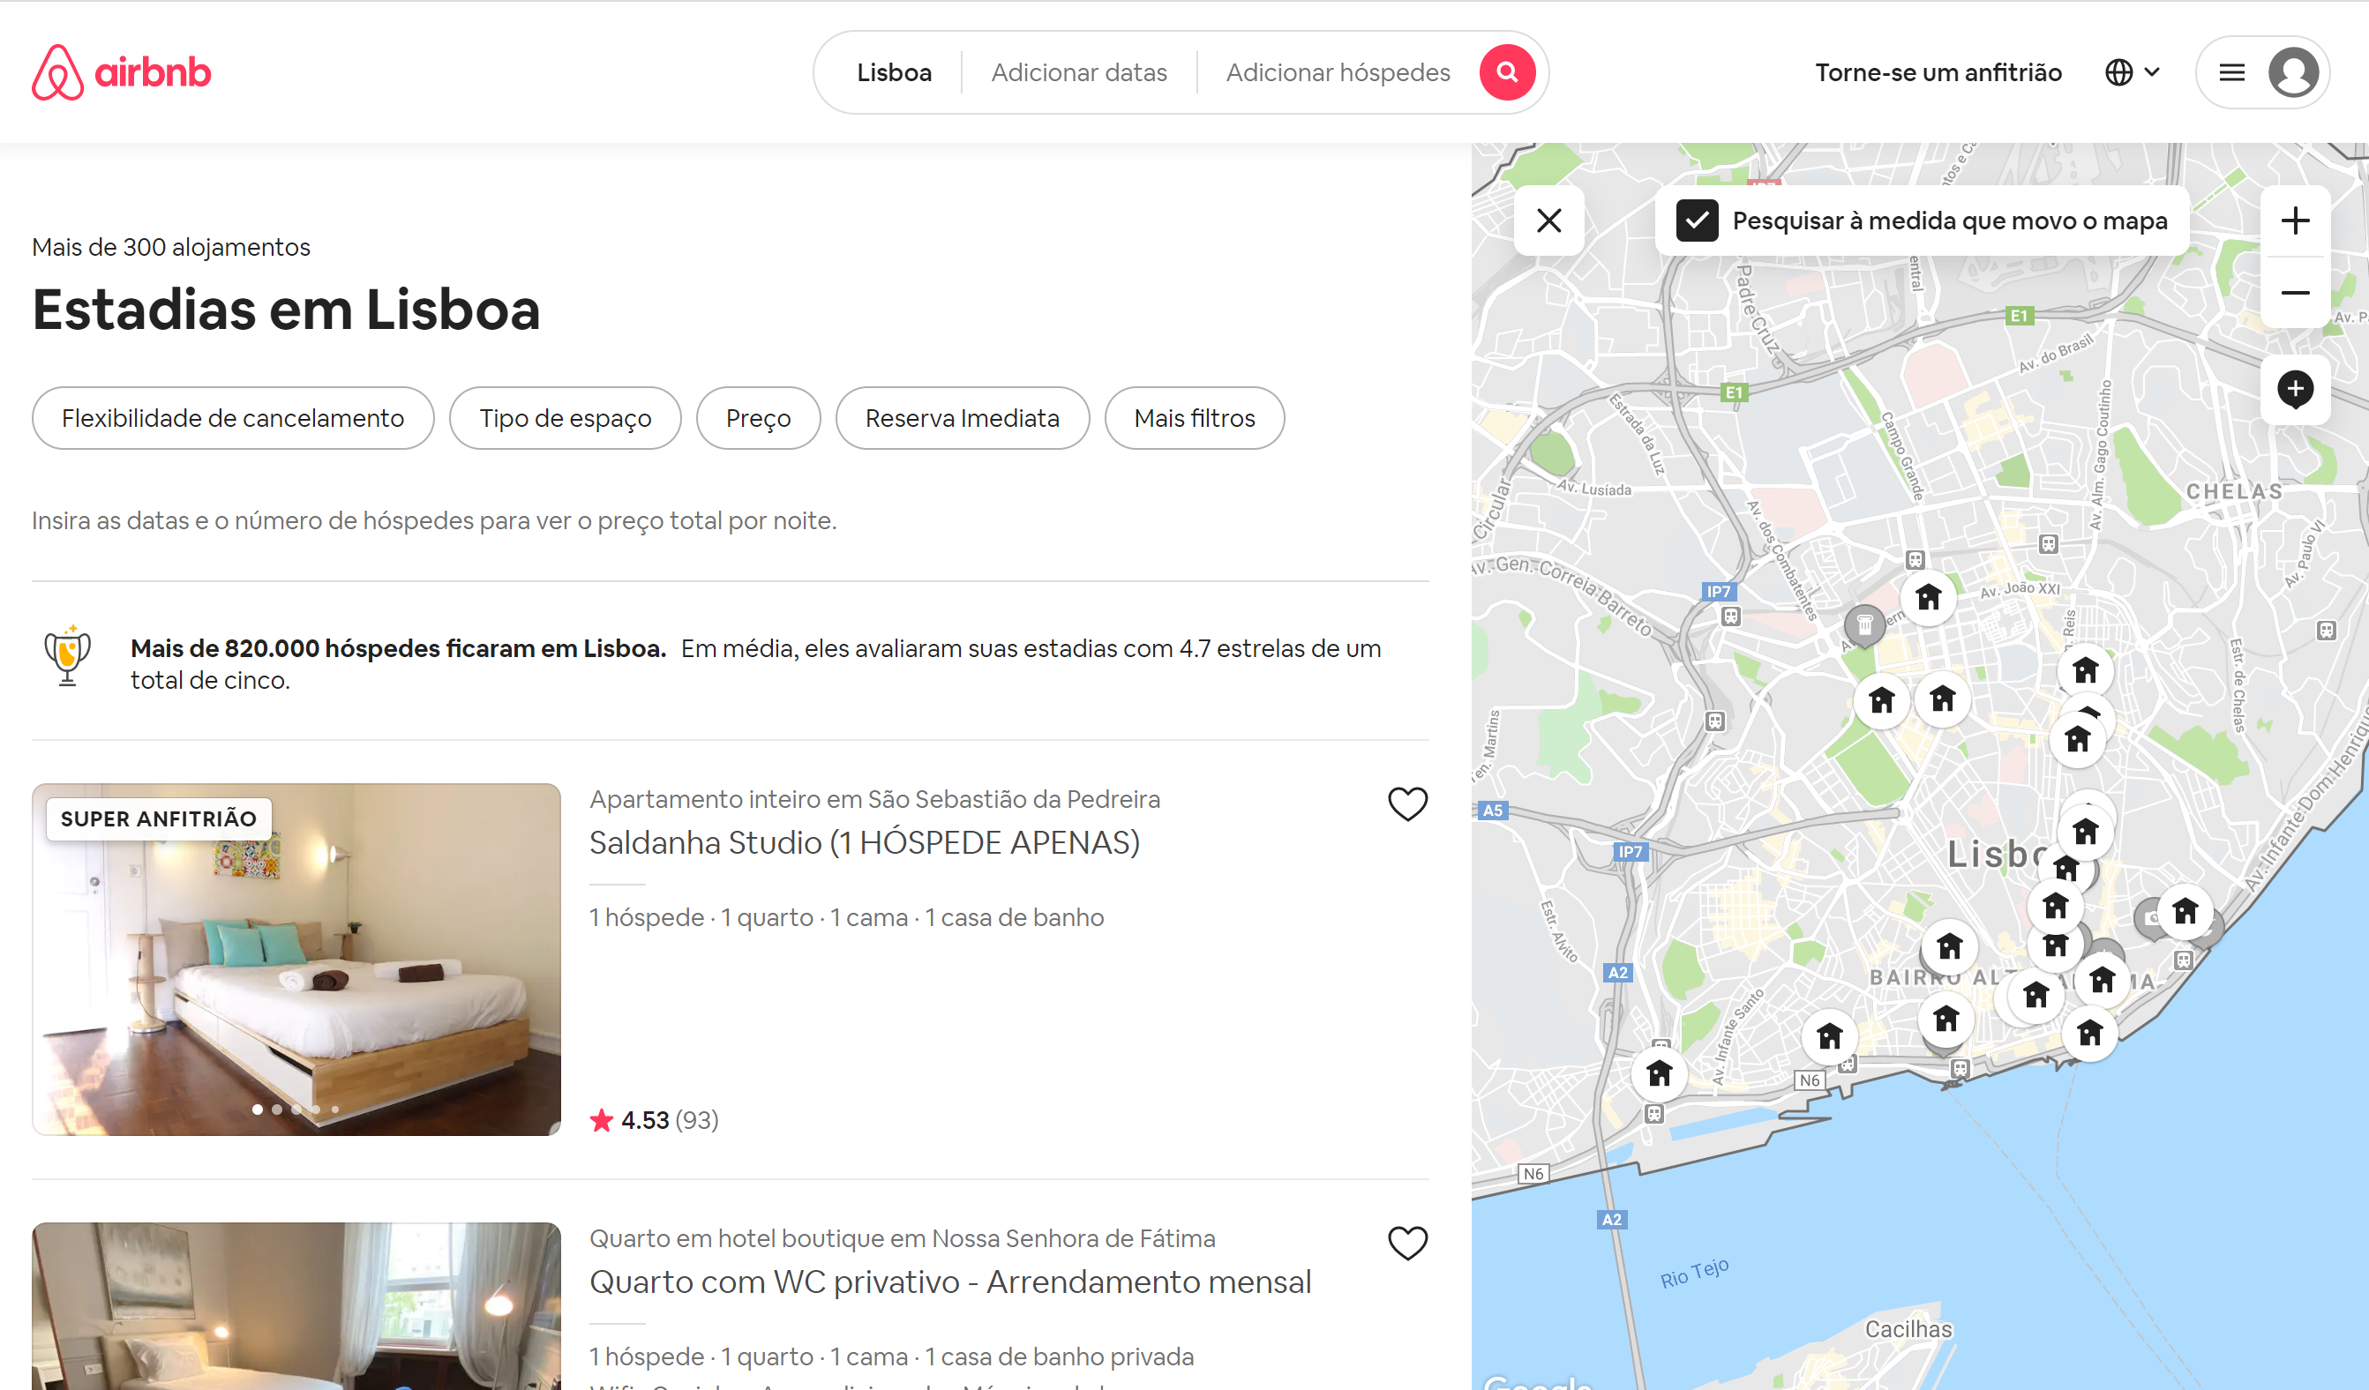
Framework: Situation
Notes:
We as digitally adept users are already trained to manipulate the spatial, temporal, and thematic attributes of databases such as AirBnB, GoogleMaps, UberEats, Glovo, Vagamundos, etc.

Slide 12
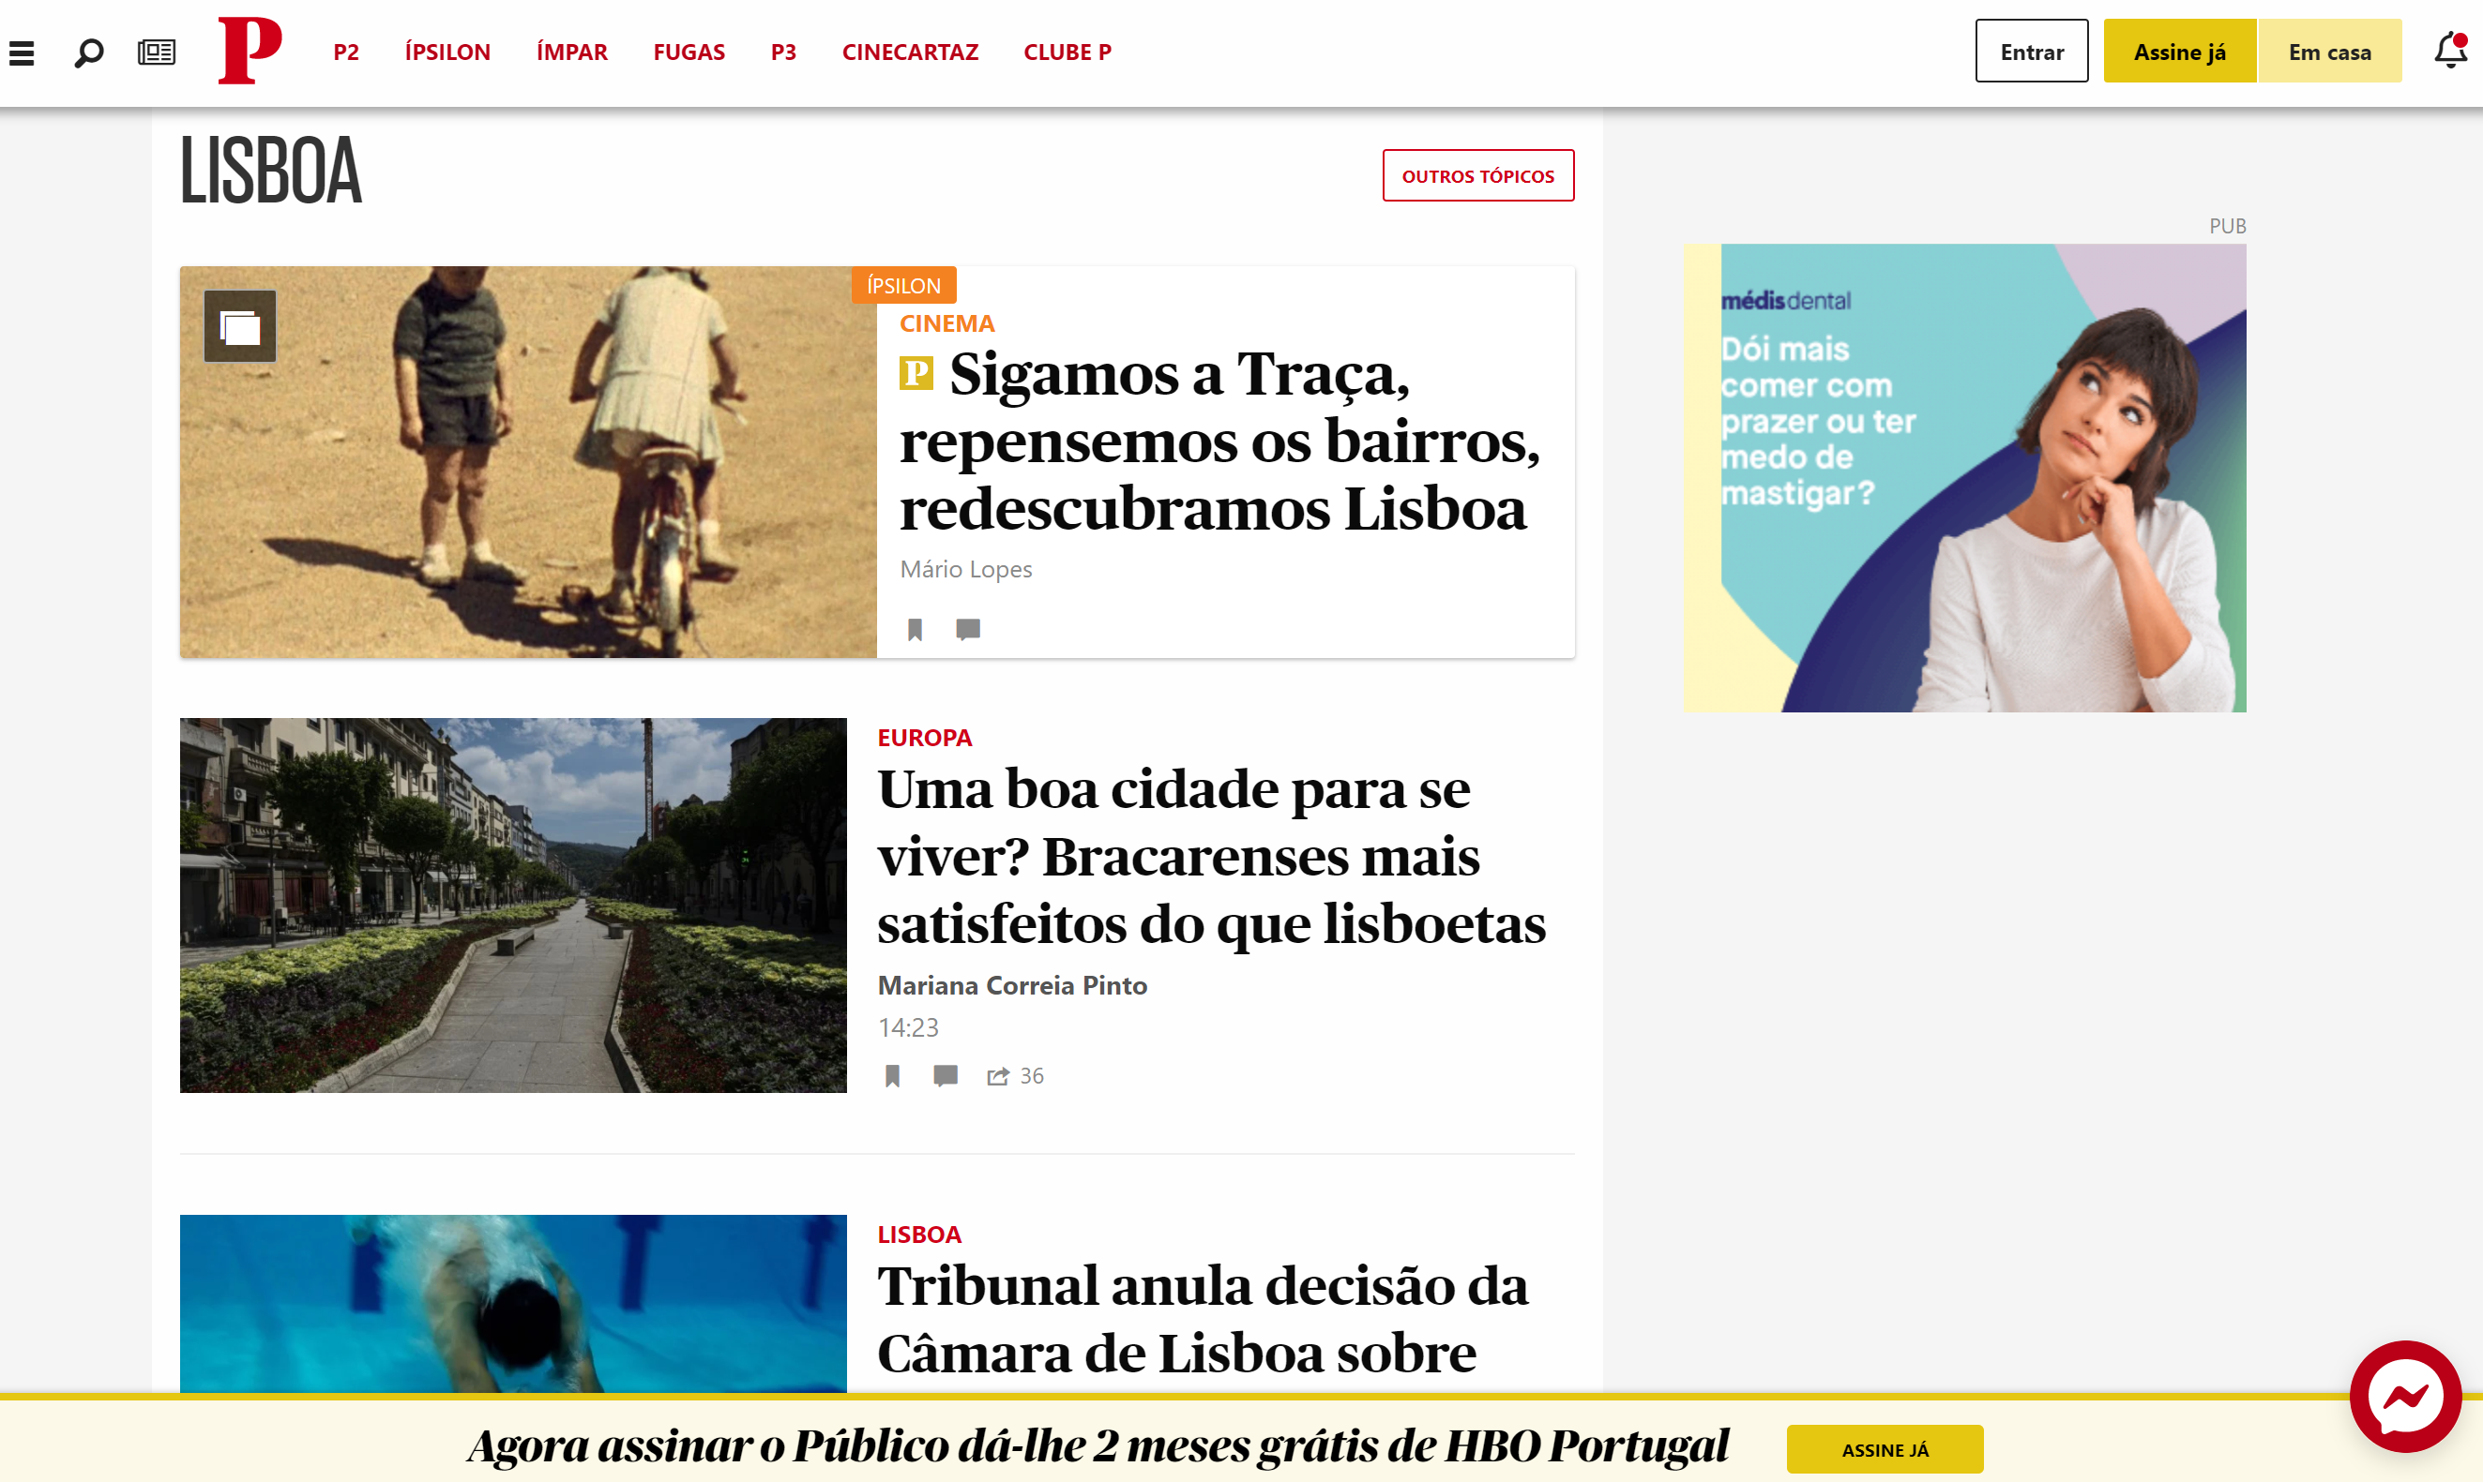
Framework: Status Quo
Notes:
This is noticeably absent from our news media. To search, we are provided only keywords or general categories. We cannot see distributions of news incidents for a given timeframe, and rarely is there even a context map to situate the potentially nuanced contents of a particular news story.
I propose to create a proof of concept webapp that tackles this void. The goal is to select a study area (Lisbon) and map the contents of news for a given study period, news source, and section (local). To do this, a suite of tools (input and manipulation) must be developed to investigate if this kind of product can provide additional citizen insight, stronger research resources, and/or official monitoring of an area to substantiate further development.
Because it is at a sub-city level, automatic extraction will likely not be appropriate to define location in many cases, and I anticipate that many areas will require custom definitions.

Slide 13
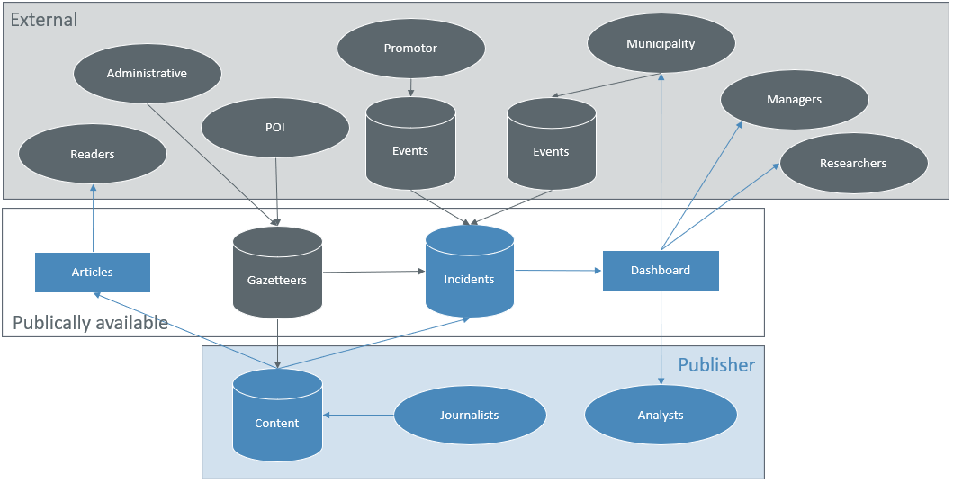
Framework: Data Flow

Slide 14
Hypothesis
Is there value in integrating a spatial component to news databases?
The association of place will provide a new dimension of understanding of incident distribution at a local level.
Publishers integrating spatial news may provide an improved user experience to readers, researchers, and monitors.

Slide 15
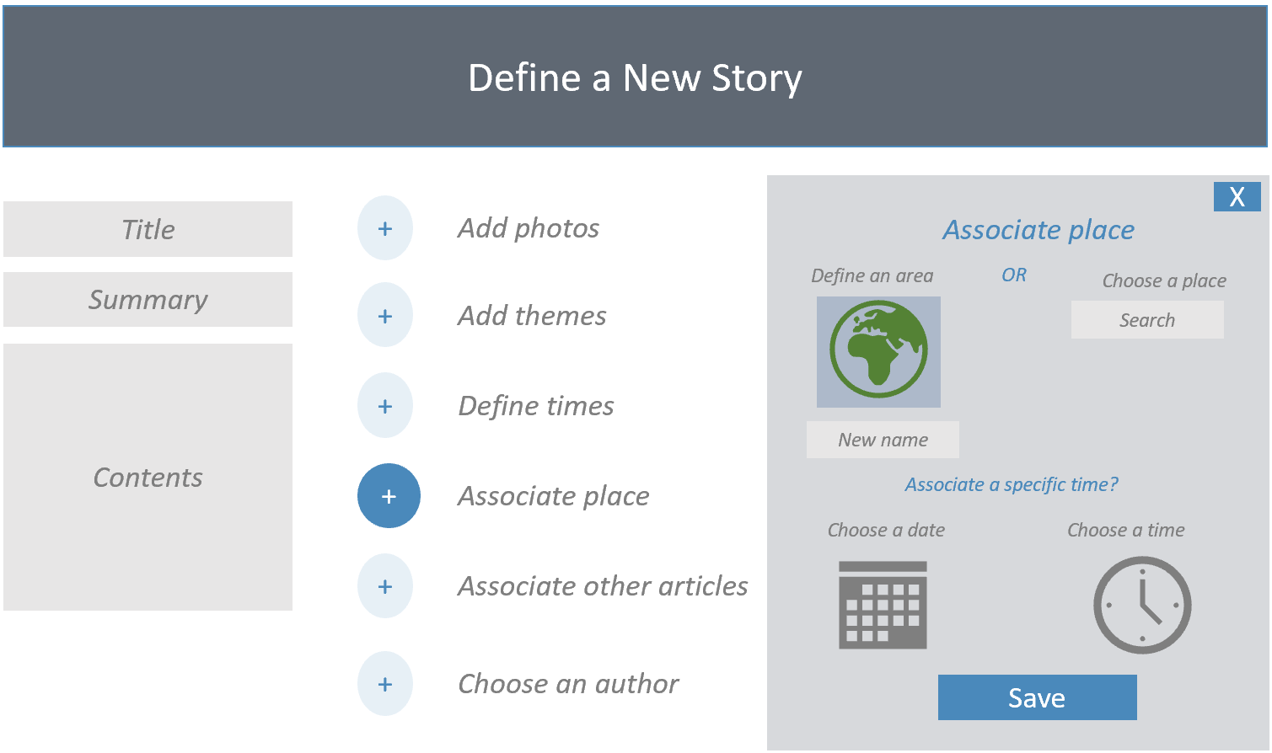
Objectives: Publisher Input Tool

Slide 16
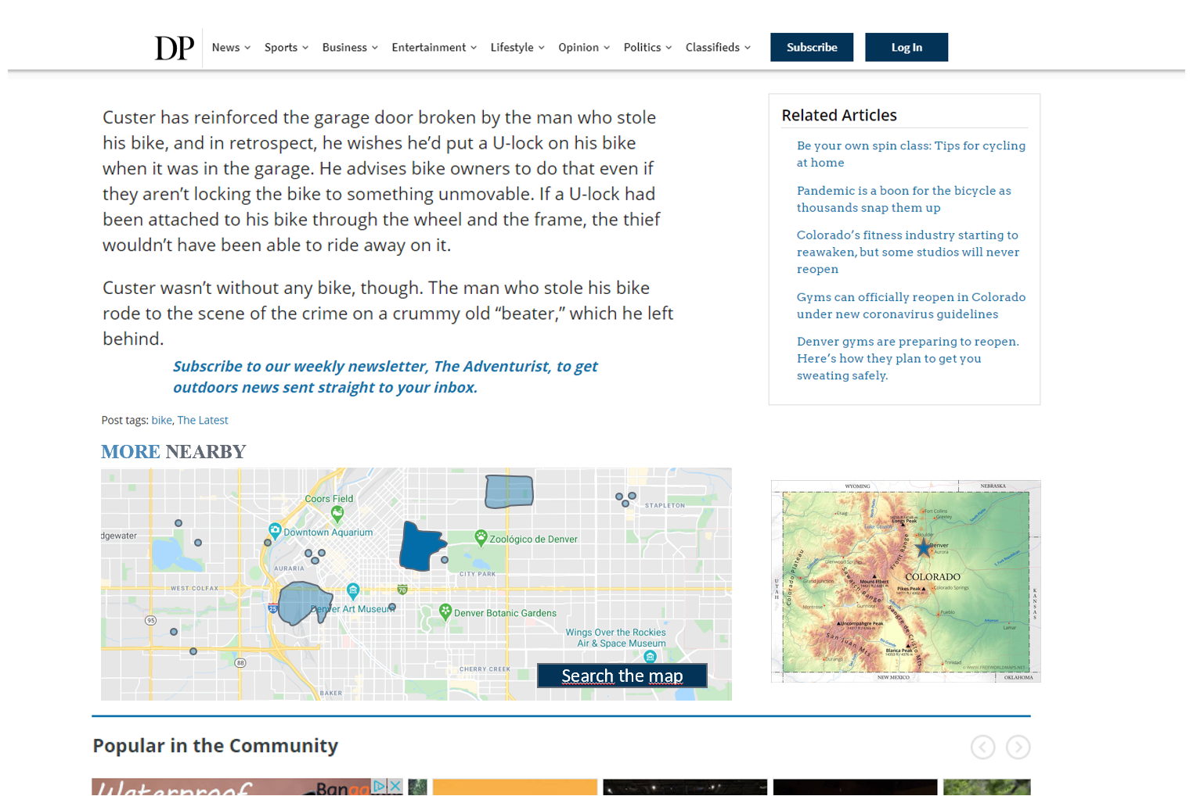
Objectives: Context Map

Slide 17
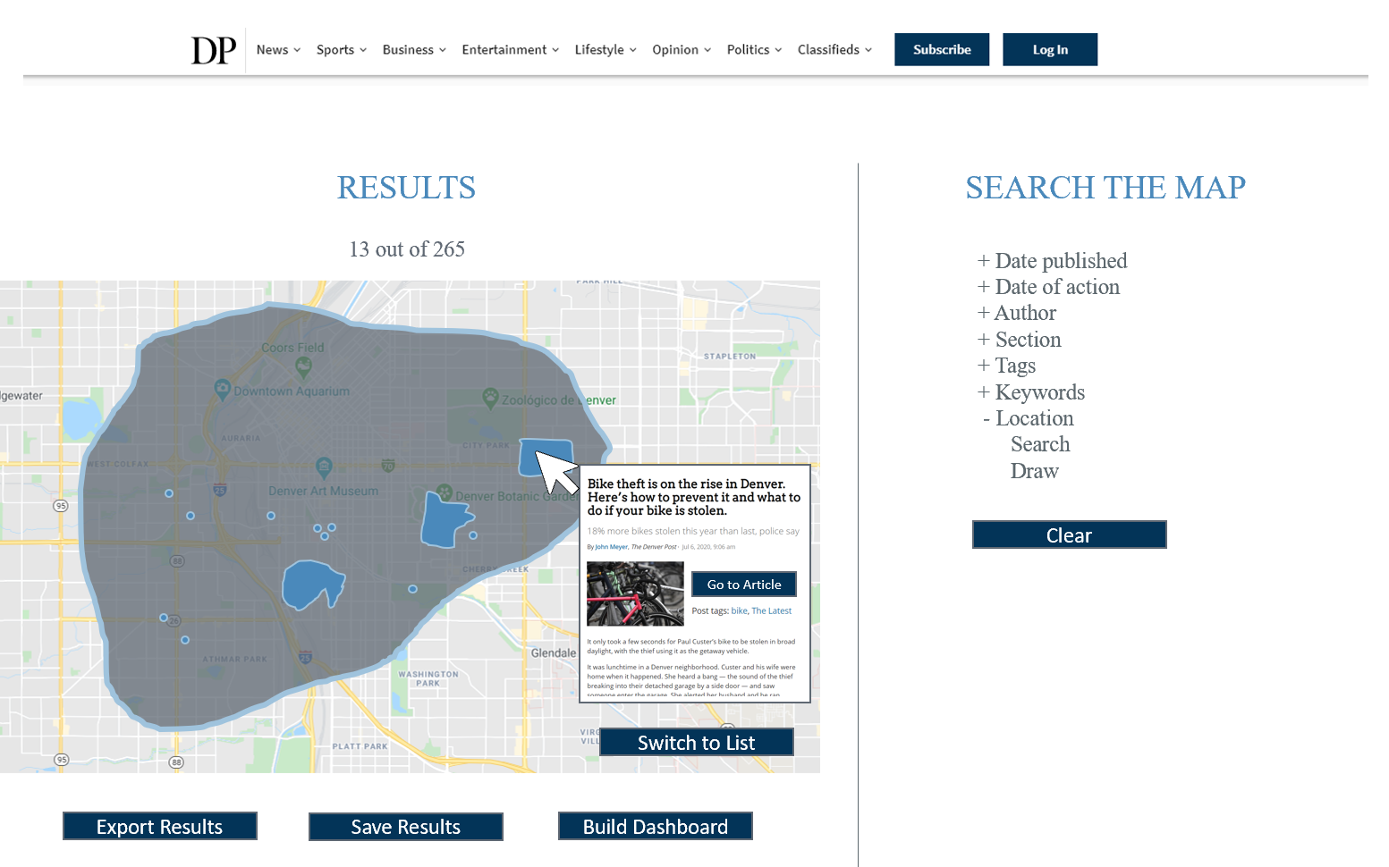
Objectives: Search Tool

Slide 18
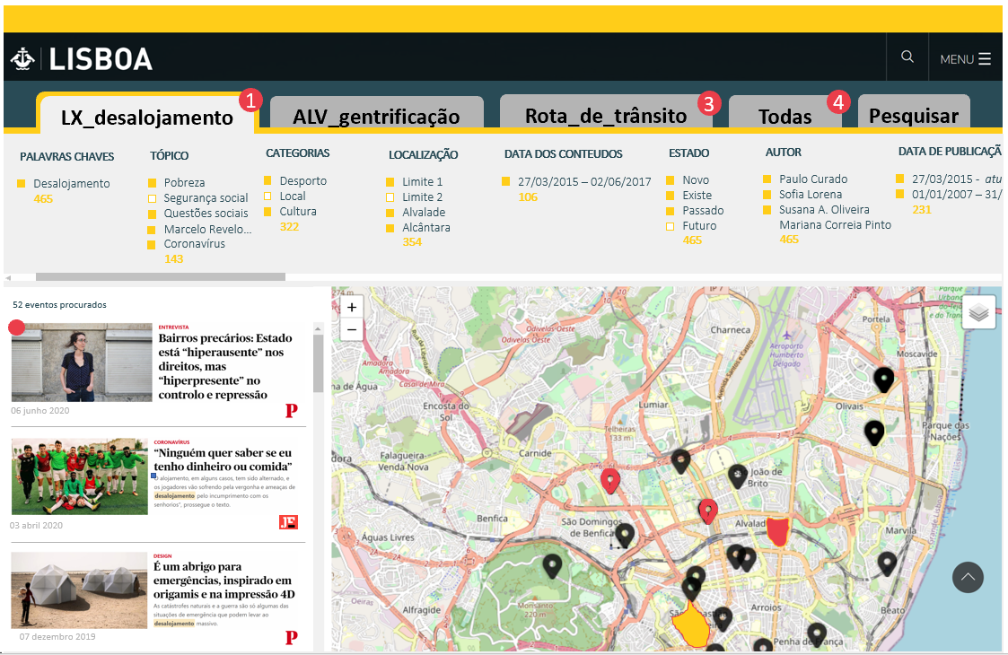
Objectives: Dashboard Tool

Slide 19
Methodology
Literature/resource review
Specification of products
Establish the development environment
Request/receive data
Establish incident DB
Load gazetteers, POI, admin boundaries
Develop and test tools
Translate and load content options
Migrate site to the server
Test among stakeholders
Document results and plan future development
Notes:
Incident DB: multiple spatial data types (point and polygons), multiple language options
Develop and test Input, Search, Context, and Dashboard tools

